Slide 1


Connecting
#13a Express & MySQL

Slide 2
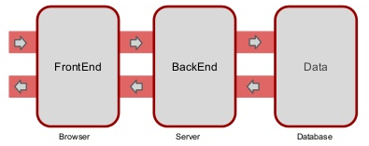




Web App Architecture

Slide 3
#1 Activate MySQL Server
Via command prompt, go to mysql.exe directory C:\Program Files\MySQL\MySQL Server 5.7\bin then execute:
$ mysql.exe --user=lintang --password=12345
Create database, table & insert an initial data:
$ CREATE DATABASE toko;
$ USE toko;
$ CREATE TABLE karyawan(
no INT NOT NULL AUTO_INCREMENT,
nama VARCHAR(30),
usia SMALLINT,
PRIMARY KEY(no));
$ INSERT INTO karyawan VALUES(‘Andi’,24);

Slide 4

#2 Install MySQL Package
MySQL package is a Node.JS driver for MySQL database. It’s written in JavaScript, doesn’t require compiling & 100% MIT licensed.
More info: npmjs.com/package/mysql
On project dir, install MySQL package:
$ npm install mysqljs/mysql
** your internet connection must be good enough while installing and/or using this package!

Slide 5
Using MySQL Package
1# Select All Data
const mysql = require('mysql');
const db = mysql.createConnection({
host : 'localhost',
user : 'lintang',
password : '12345',
database : 'toko'
});
db.connect();
var sql = 'SELECT * FROM karyawan';
db.query(sql, (err, result)=>{
if(err) throw err;
console.log(result);
});
db.end();

Slide 6
Using MySQL Package
2# Select Specific
Data
const mysql = require('mysql'); const db = mysql.createConnection({
host : 'localhost',
user : 'lintang',
password : '12345',
database : 'toko'
});
db.connect();
var nama = 'Andi'; var sql = 'SELECT * FROM karyawan WHERE nama = ?';
db.query(sql, nama, (err, result)=>{
if(err) throw err;
console.log(result);
});
db.end();

Slide 7
Using MySQL Package
3# Insert Data
const mysql = require('mysql');
const db = mysql.createConnection({
host : 'localhost',
user : 'lintang',
password : '12345',
database : 'toko'
});
db.connect();
var data = {no: null, nama:"Dedi", usia:23}; var sql = 'INSERT INTO karyawan SET ?';
db.query(sql, data, (err, result)=>{
if(err) throw err;
console.log(result);
});
db.end();

Slide 8
Using MySQL Package
4# Delete Data
const mysql = require('mysql');
const db = mysql.createConnection({
host : 'localhost',
user : 'lintang',
password : '12345',
database : 'toko'
});
db.connect();
var nama = 'Budi';
var sql = 'DELETE from karyawan WHERE nama=?';
db.query(sql, nama, (err, result)=>{
if(err) throw err;
console.log(result);
});
db.end();

Slide 9
Using MySQL Package
5a# Update Data
const mysql = require('mysql');
const db = mysql.createConnection({
host : 'localhost',
user : 'lintang',
password : '12345',
database : 'toko'
});
db.connect();
var nama = 'Andi';
var sql = 'UPDATE karyawan SET nama="Zizi" WHERE nama=?';
db.query(sql, nama, (err, result)=>{
if(err) throw err;
console.log(result);
});
db.end();

Slide 10
Using MySQL Package
5b# Update Data
const mysql = require('mysql');
const db = mysql.createConnection({
host : 'localhost',
user : 'lintang',
password : '12345',
database : 'toko'
});
db.connect();
var x = 'Yaya';
var y = 'Caca'
var sql = 'UPDATE karyawan SET nama=? WHERE nama=?';
db.query(sql, [x,y], (err, result)=>{
if(err) throw err;
console.log(result);
});
db.end();

Slide 11


Express & MySQL

Slide 12
Express & MySQL
#Basic
const express = require('express');
const app = express();
const mysql = require('mysql');
const db = mysql.createConnection({
host : 'localhost',
user : 'lintang',
password : '12345',
database : 'toko'
});
db.connect();
# # # # # # route here # # # # # #
app.listen(3000, ()=>{
console.log('Server @port 3000')
});

Slide 13
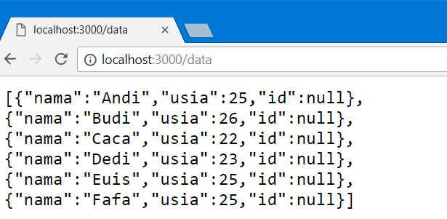
Express & MySQL
#GET Route to Select All Data
app.get('/data', function(req,res){
var sql = 'SELECT * FROM karyawan';
db.query(sql, (err, result)=>{
if(err) throw err;
console.log(result);
res.send(result);
});
});

Slide 14
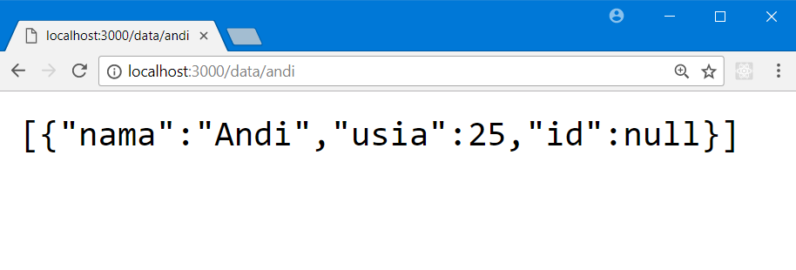
Express & MySQL
#GET Route to Select Spesific Data
app.get('/data/:id', function(req,res){
var sql = `SELECT * FROM karyawan WHERE nama = '${req.params.id}'`;
db.query(sql, (err, result)=>{
if(err) throw err;
console.log(result);
res.send(result);
});
});

Slide 15
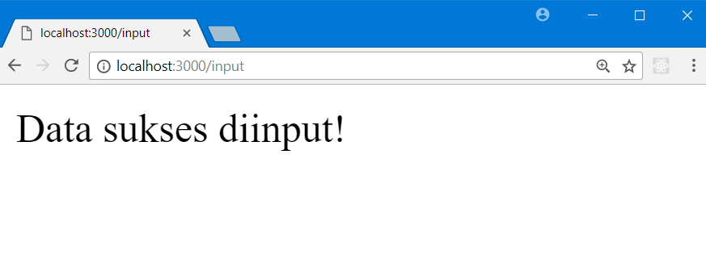
Express & MySQL
#GET Route to Insert Data
app.get('/input', function(req,res){
var data = {nama:"Siti", usia:21};
var sql = 'INSERT INTO karyawan SET ?';
db.query(sql, data, (err, result)=>{
if(err) throw err;
console.log(result);
res.send('Data sukses diinput!')
});
});
Then see data on
/data or MySQL!

Slide 16
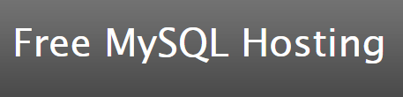
Express & MySQL Hosting

Slide 17
Connecting
#13a Express & MySQL

